Slide 1

PITTER ENTERPRISES LLC
Fab Pilot
A closer look at the fabrication shop workflow
Estimating • Production • Time • Job costs
Built in a fabrication shop. Designed for fabrication shops.
PRODUCT WALKTHROUGH / SEPTEMBER 2026
Notes:
Fab Pilot product reference: https://fabpilot-pitter.russellpitter.chatgpt.site
Product scope: owner discussions and confirmed published updates, September 4–25, 2026.
Built in a fabrication shop. Designed for fabrication shops.
Conceptual steel artwork from the prior Pilot marketing package; not a photograph of a company facility.
Business contact source: Pitter_Enterprises_LLC_BIR_Form.docx, August 29, 2026.
Screens shown were captured during September 2026; interface details may evolve.

Slide 2
The fabrication job cycle
Keep the estimate, released work and job review connected.
01
Estimate and prepare
Review CAD, materials, operation hours, outside services and pricing.
02
Release and run
Set work packages, quantities, process order, assignments and priorities.
03
Review and bill
Compare quoted and actual costs, then hand completed work to Invoice Pilot.
FAB PILOT / PITTER ENTERPRISES LLC
02
Notes:
Fab Pilot product reference: https://fabpilot-pitter.russellpitter.chatgpt.site
Product scope: owner discussions and confirmed published updates, September 4–25, 2026.
Built in a fabrication shop. Designed for fabrication shops.
Business contact source: Pitter_Enterprises_LLC_BIR_Form.docx, August 29, 2026.
Screens shown were captured during September 2026; interface details may evolve.

Slide 3
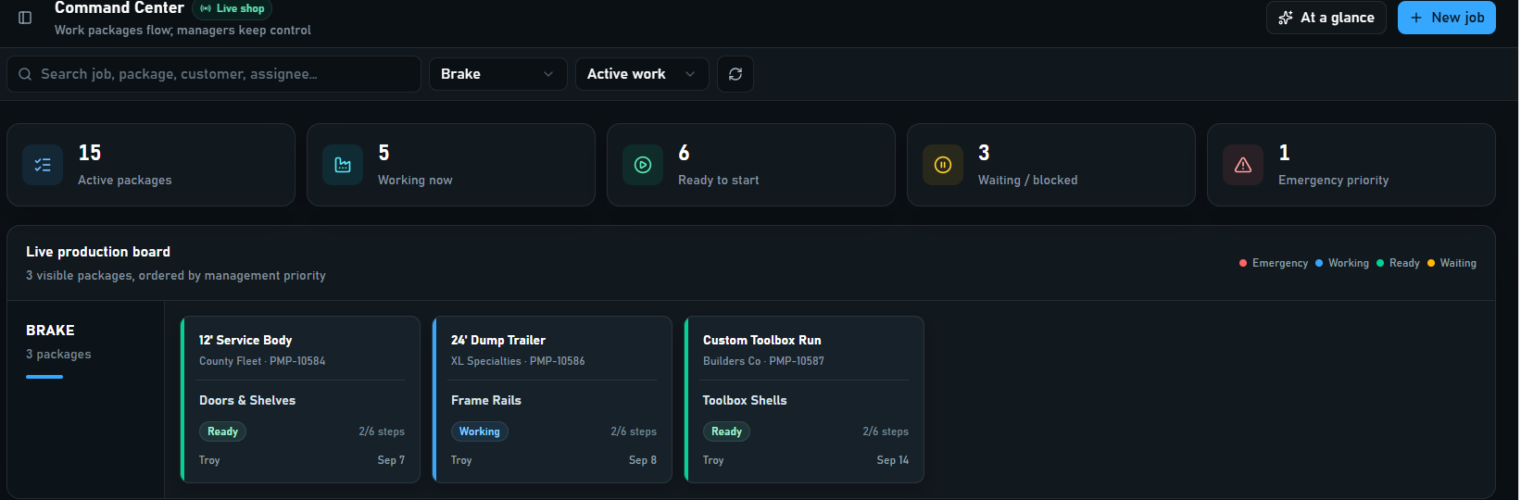
Command Center
Command Center: active work, priorities and production status
See work status
Find the job
Keep control
Ready, working, waiting and emergency work.
Search and filter by station or active work.
Managers set the order of work.
FAB PILOT / PITTER ENTERPRISES LLC
03
Notes:
Fab Pilot product reference: https://fabpilot-pitter.russellpitter.chatgpt.site
Product scope: owner discussions and confirmed published updates, September 4–25, 2026.
September 3 and September 10 Command Center screenshots.
Image source: owner-provided Screenshot 2026-09-03 093618.png; libfile_af6320c956c08191b8784cb13b7c396c. Captured September 3, 2026. Cropped for legibility; values are not product pricing or performance claims.
Business contact source: Pitter_Enterprises_LLC_BIR_Form.docx, August 29, 2026.
Screens shown were captured during September 2026; interface details may evolve.

Slide 4
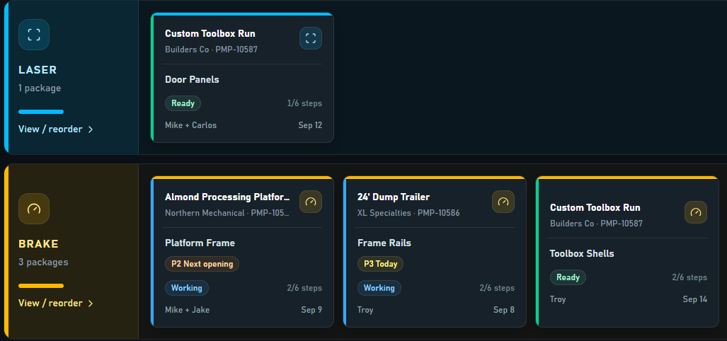
Work organized by station
Your process flow
Arrange operations and station lanes around the shop.
Clear assignments
See the people, package and next process.
Simple actions
Start, pause, resume and move work forward.
Station lanes: assignments, process status and manager priorities
FAB PILOT / PITTER ENTERPRISES LLC
04
Notes:
Fab Pilot product reference: https://fabpilot-pitter.russellpitter.chatgpt.site
Product scope: owner discussions and confirmed published updates, September 4–25, 2026.
September 10 station-lane screenshot.
Image source: owner-provided Screenshot 2026-09-10 163436.png; libfile_9eb565fe13888191ba5992e99bf775d6. Captured September 10, 2026. Cropped for legibility; values are not product pricing or performance claims.
Business contact source: Pitter_Enterprises_LLC_BIR_Form.docx, August 29, 2026.
Screens shown were captured during September 2026; interface details may evolve.

Slide 5
Progressive releases and quantities
Release the portion that is ready while the rest of the job develops.
01
Split a project into work packages
Give released work its own route, quantity, status and assignments.
02
Track partial progress
Record quantities and partial completion without closing the whole job.
03
Set the pace
Use job due dates, optional process dates, priorities and emergency handling.
04
Manage the floor
Reorder processes and work; keep blocked or waiting work visible.
FAB PILOT / PITTER ENTERPRISES LLC
05
Notes:
Fab Pilot product reference: https://fabpilot-pitter.russellpitter.chatgpt.site
Product scope: owner discussions and confirmed published updates, September 4–25, 2026.
September 8 repeat-release publication; September 22 quantities/partial tracking update.
Business contact source: Pitter_Enterprises_LLC_BIR_Form.docx, August 29, 2026.
Screens shown were captured during September 2026; interface details may evolve.

Slide 6
Employee time and shared shop stations
Capture payroll attendance and job time as separate records.
01
PIN clock-in and clock-out
Employees use a shared shop station to clock in and select work.
02
Independent worker timing
Several people can work on one job. One person's clock-out does not stop coworkers.
03
Pause and resume
Clock-out pauses that employee's active timers; clock-in resumes still-valid paused work.
04
Concurrent work
Track work across jobs or machines. Job hours can differ from elapsed payroll hours.
FAB PILOT / PITTER ENTERPRISES LLC
06
Notes:
Fab Pilot product reference: https://fabpilot-pitter.russellpitter.chatgpt.site
Product scope: owner discussions and confirmed published updates, September 4–25, 2026.
September 9 employee timing publication; September 24 shared-station publication.
Business contact source: Pitter_Enterprises_LLC_BIR_Form.docx, August 29, 2026.
Screens shown were captured during September 2026; interface details may evolve.

Slide 7
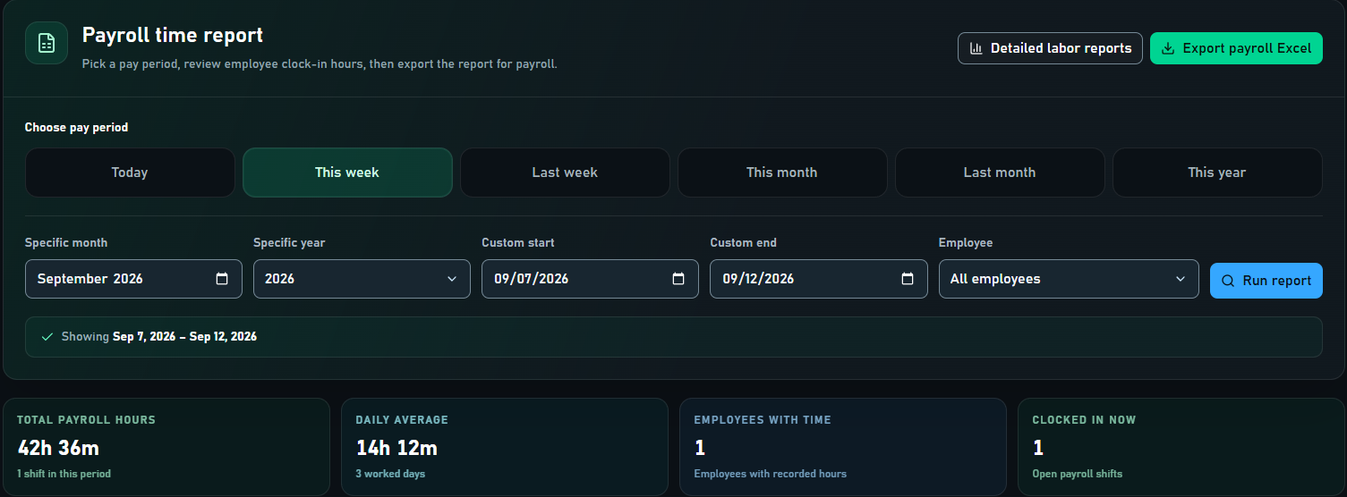
Payroll and labor reporting
Payroll reports: pay periods, employee filters and Excel export
Flexible periods
Review and export
Leave settings
Day, week, month, year or a custom range.
Employee filters, totals, daily averages and Excel.
Sick/vacation accrual and overtime-related settings.
Payroll reporting supports review and export; it is not a payroll payment service.
FAB PILOT / PITTER ENTERPRISES LLC
07
Notes:
Fab Pilot product reference: https://fabpilot-pitter.russellpitter.chatgpt.site
Product scope: owner discussions and confirmed published updates, September 4–25, 2026.
September 12 payroll and leave settings publication.
Image source: owner-provided Screenshot 2026-09-12 091942.png; libfile_ac7852236ecc8191b7b99438e8bf58bb. Captured September 12, 2026. Cropped for legibility; values are not product pricing or performance claims.
Presenter detail: Payroll reporting supports review and export; it is not a payroll payment service.
Business contact source: Pitter_Enterprises_LLC_BIR_Form.docx, August 29, 2026.
Screens shown were captured during September 2026; interface details may evolve.

Slide 8
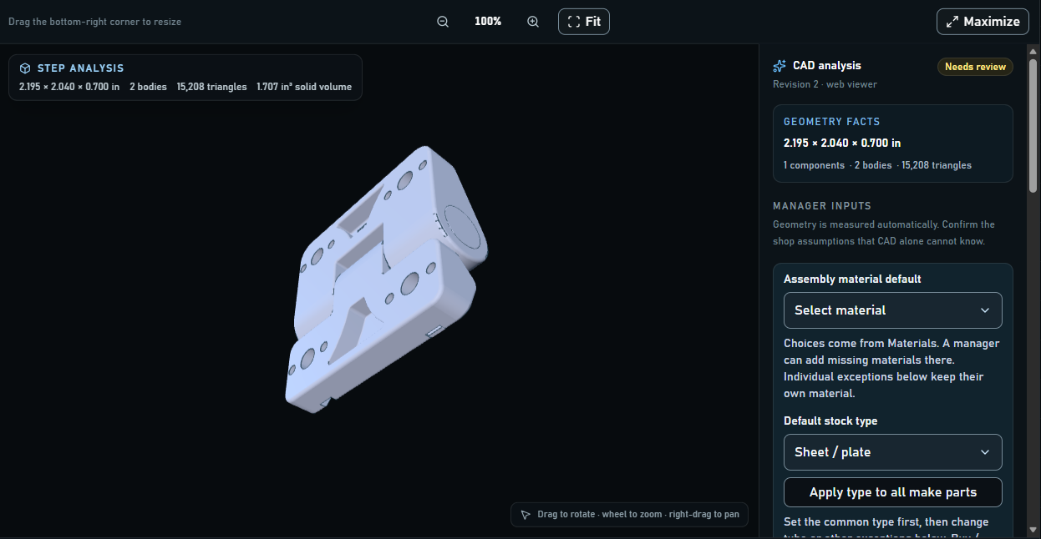
CAD review inside the job
STEP and DXF
Inspect 3D models and 2D drawing geometry.
Useful measurements
Review dimensions, bodies and detected stock details.
Manager judgment
Confirm material, stock type, process and finish.
STEP viewer: 3D geometry, dimensions and manager review inputs
Geometry provides estimating inputs; shop assumptions and final pricing require review.
FAB PILOT / PITTER ENTERPRISES LLC
08
Notes:
Fab Pilot product reference: https://fabpilot-pitter.russellpitter.chatgpt.site
Product scope: owner discussions and confirmed published updates, September 4–25, 2026.
September 4 CAD viewer and estimate workspace publication; September 22 viewer screenshot.
Image source: owner-provided Screenshot 2026-09-22 073512.png; libfile_f5c07699ef5481918f44185075988db6. Captured September 22, 2026. Cropped for legibility; values are not product pricing or performance claims.
Presenter detail: Geometry provides estimating inputs; shop assumptions and final pricing require review.
Business contact source: Pitter_Enterprises_LLC_BIR_Form.docx, August 29, 2026.
Screens shown were captured during September 2026; interface details may evolve.

Slide 9
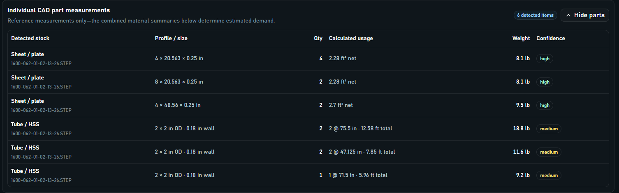
Material takeoffs and part measurements
CAD part measurements: stock type, usage, weight and confidence
Review detected parts
Check confidence
Plan the material
Stock type, dimensions, quantities and weight.
Review detection quality and correct assumptions.
Use consolidated material requirements in the estimate.
FAB PILOT / PITTER ENTERPRISES LLC
09
Notes:
Fab Pilot product reference: https://fabpilot-pitter.russellpitter.chatgpt.site
Product scope: owner discussions and confirmed published updates, September 4–25, 2026.
September 5 part-measurement screenshot.
Image source: owner-provided Screenshot 2026-09-05 093556.png; libfile_bf4932e064bc81918b5c83972584794c. Captured September 5, 2026. Cropped for legibility; values are not product pricing or performance claims.
Business contact source: Pitter_Enterprises_LLC_BIR_Form.docx, August 29, 2026.
Screens shown were captured during September 2026; interface details may evolve.

Slide 10
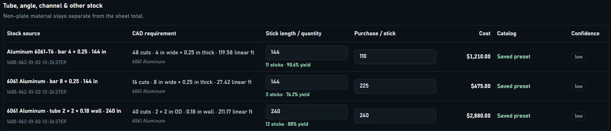
Stock usage and material pricing
Stock estimating: material requirements, stick usage and purchase cost
Multiple stock types
Usage and cost
Pricing control
Sheet/plate, tube, angle, channel, bar and other stock.
Review stick lengths, quantities, yield and cost.
Save catalog presets and edit purchase/selling prices.
Confirm material demand against the approved production package before buying or cutting.
FAB PILOT / PITTER ENTERPRISES LLC
10
Notes:
Fab Pilot product reference: https://fabpilot-pitter.russellpitter.chatgpt.site
Product scope: owner discussions and confirmed published updates, September 4–25, 2026.
September 7 materials/pricing screenshot.
Image source: owner-provided Screenshot 2026-09-07 064555.png; libfile_2b3920c8f96c81918f8f3a02159514ef. Captured September 7, 2026. Cropped for legibility; values are not product pricing or performance claims.
Presenter detail: Confirm material demand against the approved production package before buying or cutting.
Business contact source: Pitter_Enterprises_LLC_BIR_Form.docx, August 29, 2026.
Screens shown were captured during September 2026; interface details may evolve.

Slide 11
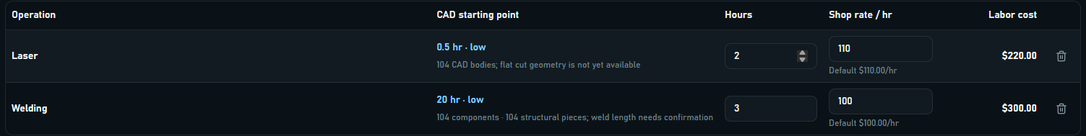
A complete estimating workspace
Operation labor: editable hours, shop rates and calculated labor values
Labor by operation
More than material
Price and review
Enter hours and shop rates for each process.
Include outside services, overhead and adjustments.
Apply margin; review cost, selling price and expected profit.
Save estimate drafts and quote variants, review them, then convert approved work to a project.
FAB PILOT / PITTER ENTERPRISES LLC
11
Notes:
Fab Pilot product reference: https://fabpilot-pitter.russellpitter.chatgpt.site
Product scope: owner discussions and confirmed published updates, September 4–25, 2026.
September 4 estimate workspace publication; September 5 labor screenshot.
Image source: owner-provided Screenshot 2026-09-05 101007.png; libfile_3744dc8dcf488191a925b23061a0a216. Captured September 5, 2026. Cropped for legibility; values are not product pricing or performance claims.
Presenter detail: Save estimate drafts and quote variants, review them, then convert approved work to a project.
Business contact source: Pitter_Enterprises_LLC_BIR_Form.docx, August 29, 2026.
Screens shown were captured during September 2026; interface details may evolve.

Slide 12
Quotation-level nesting
Understand material demand before committing to production.
01
Rectangular blank layouts
Use CAD envelopes and detected geometry to estimate sheet and stock usage.
02
Sheet choices and utilization
Review selected sheet presets, sheet count, square-foot usage, waste and cost.
03
Readable nest sheets
View numbered blanks with part names, sizes, quantities and per-sheet breakdowns.
04
Print for review
Print one nest or all nests. These are estimating layouts, not finished cutting contours.
FAB PILOT / PITTER ENTERPRISES LLC
12
Notes:
Fab Pilot product reference: https://fabpilot-pitter.russellpitter.chatgpt.site
Product scope: owner discussions and confirmed published updates, September 4–25, 2026.
September 4 quotation-level rectangular nesting; September 10 nest viewing/printing publication. Production cutting contours are outside this scope.
Business contact source: Pitter_Enterprises_LLC_BIR_Form.docx, August 29, 2026.
Screens shown were captured during September 2026; interface details may evolve.

Slide 13
Repeat parts and new releases
Repeat parts: release again, edit, files, material export and repricing
Keep the job knowledge
Release again
Review the new run
Retain route, materials, files, labor and purchased-part BOM.
Choose a new quantity and create a new job number.
Adjust dates and details; reprice against current costs.
Existing floor releases stay in place. Review any inactive processes before the next release.
FAB PILOT / PITTER ENTERPRISES LLC
13
Notes:
Fab Pilot product reference: https://fabpilot-pitter.russellpitter.chatgpt.site
Product scope: owner discussions and confirmed published updates, September 4–25, 2026.
September 8 repeat-parts release publication; September 10 repeat-parts screenshot.
Image source: owner-provided Screenshot 2026-09-10 151607.png; libfile_b66d5c7054f8819181e5965e7f6f3c79. Captured September 10, 2026. Cropped for legibility; values are not product pricing or performance claims.
Presenter detail: Existing floor releases stay in place. Review any inactive processes before the next release.
Business contact source: Pitter_Enterprises_LLC_BIR_Form.docx, August 29, 2026.
Screens shown were captured during September 2026; interface details may evolve.

Slide 14
Purchasing and job readiness
Keep material needs and outside work connected to the job.
01
Material requirements
Use the job's material and purchased-part information to prepare buying decisions.
02
Purchasing records
Track purchasing, reservations and receipts for the work being released.
03
Outside services
Include subcontracted processes and their costs in the job and estimate.
04
Readiness visibility
Keep waiting or blocked packages visible as material and outside work progress.
FAB PILOT / PITTER ENTERPRISES LLC
14
Notes:
Fab Pilot product reference: https://fabpilot-pitter.russellpitter.chatgpt.site
Product scope: owner discussions and confirmed published updates, September 4–25, 2026.
September 22 purchasing, reservations and receipts publication.
Business contact source: Pitter_Enterprises_LLC_BIR_Form.docx, August 29, 2026.
Screens shown were captured during September 2026; interface details may evolve.

Slide 15
Files, drawing approvals and quality
Keep the production package available where the work happens.
01
Job files and viewers
Keep PDFs, drawings, images and CAD with the project; view or download them.
02
Drawing approval
Review drawings and approval status before the work is released.
03
Quality control
Use QC steps and records where the job calls for them.
04
Packing slips
Prepare packing slips and retain the job's completion records.
FAB PILOT / PITTER ENTERPRISES LLC
15
Notes:
Fab Pilot product reference: https://fabpilot-pitter.russellpitter.chatgpt.site
Product scope: owner discussions and confirmed published updates, September 4–25, 2026.
September 22 drawing approval, QC and packing-slip publication.
Business contact source: Pitter_Enterprises_LLC_BIR_Form.docx, August 29, 2026.
Screens shown were captured during September 2026; interface details may evolve.

Slide 16
Capacity and shop reporting
Use the planned work and recorded time to see where attention is needed.
01
Capacity estimates
Compare planned workload with the shop's available capacity.
02
Labor detail
Review time by employee, job, process or station with date filters.
03
Management summaries
Review quoted, billed, labor and material figures across reporting periods.
04
Data for follow-up
Export reports to Excel and use completed jobs to inform the next estimate.
FAB PILOT / PITTER ENTERPRISES LLC
16
Notes:
Fab Pilot product reference: https://fabpilot-pitter.russellpitter.chatgpt.site
Product scope: owner discussions and confirmed published updates, September 4–25, 2026.
September 22 capacity estimates; September 12 filtered labor and job summaries.
Business contact source: Pitter_Enterprises_LLC_BIR_Form.docx, August 29, 2026.
Screens shown were captured during September 2026; interface details may evolve.

Slide 17
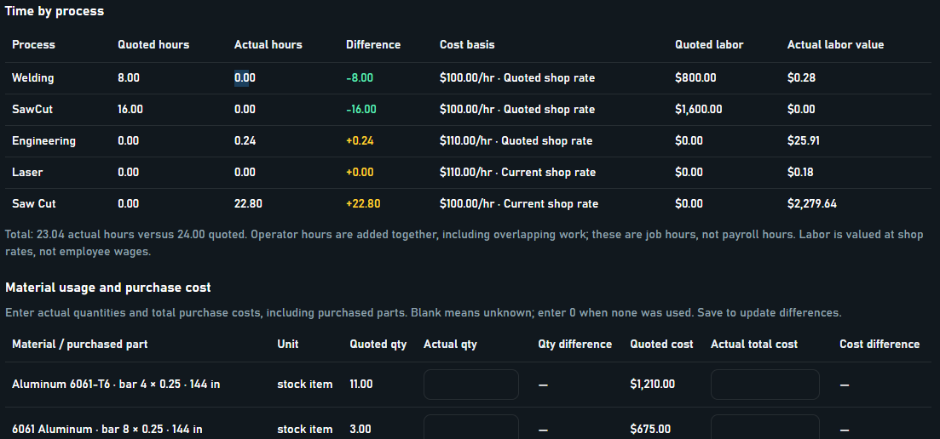
Quoted versus actual
Compare the scope
Use the saved quote and quantity as the baseline.
Review the actuals
Check process hours, material usage and outside costs.
Keep the evidence
Adjust reviewed values while preserving raw clock records.
Quote-versus-actual review: process hours and material quantities
Record the reason and review history when correcting actual hours.
FAB PILOT / PITTER ENTERPRISES LLC
17
Notes:
Fab Pilot product reference: https://fabpilot-pitter.russellpitter.chatgpt.site
Product scope: owner discussions and confirmed published updates, September 4–25, 2026.
September 12 actual-hours and cost-review publication.
Image source: owner-provided Screenshot 2026-09-12 085603.png; libfile_81215b27a4d08191b0de0ed60bf2fbd7. Captured September 12, 2026. Cropped for legibility; values are not product pricing or performance claims.
Presenter detail: Record the reason and review history when correcting actual hours.
Business contact source: Pitter_Enterprises_LLC_BIR_Form.docx, August 29, 2026.
Screens shown were captured during September 2026; interface details may evolve.

Slide 18
Direct costs and job profitability
Separate what the shop charges from what the job costs.
01
Employee cost and shop rate
Review employee pay cost separately from the shop's selling rate.
02
Overlapping work
Share elapsed labor cost across overlapping jobs while retaining original hours.
03
Complete the cost picture
Include materials and direct job costs; flag missing cost information.
04
Compare distinct totals
Keep quoted price, reviewed job cost and invoice subtotal clear.
FAB PILOT / PITTER ENTERPRISES LLC
18
Notes:
Fab Pilot product reference: https://fabpilot-pitter.russellpitter.chatgpt.site
Product scope: owner discussions and confirmed published updates, September 4–25, 2026.
September 22 direct-cost publication.
Business contact source: Pitter_Enterprises_LLC_BIR_Form.docx, August 29, 2026.
Screens shown were captured during September 2026; interface details may evolve.

Slide 19
The Invoice Pilot billing handoff
An optional connection to the separate Invoice Pilot app.
01
Bring the job details forward
Transfer linked customer/PO information, hours, materials, costs and billing totals.
02
Review an editable draft
Prepare the invoice in Invoice Pilot with the original Fab Pilot records protected.
03
Support partial billing
Partial invoices leave the job in Completed for the remaining balance.
04
Close the billing loop
Full invoicing marks the job billed and moves it to Job History; retries avoid duplicates.
FAB PILOT / PITTER ENTERPRISES LLC
19
Notes:
Fab Pilot product reference: https://fabpilot-pitter.russellpitter.chatgpt.site
Product scope: owner discussions and confirmed published updates, September 4–25, 2026.
September 25 Invoice Pilot bridge publication.
Business contact source: Pitter_Enterprises_LLC_BIR_Form.docx, August 29, 2026.
Screens shown were captured during September 2026; interface details may evolve.

Slide 20
Set up Fab Pilot for your shop
Configure access, station use and controls around your workflow.
01
Roles and permissions
Administrator, manager and employee access; control sensitive screens and actions.
02
Personal or shared access
Use personal web access or manager-paired shop stations with station and employee PINs.
03
Shop preferences
Configure processes, stations, rates and display choices, including high contrast.
04
Backup and recovery
Use backup controls, health alerts and separate-company restore. Automatic runs require an open, signed-in shop screen.
FAB PILOT / PITTER ENTERPRISES LLC
20
Notes:
Fab Pilot product reference: https://fabpilot-pitter.russellpitter.chatgpt.site
Product scope: owner discussions and confirmed published updates, September 4–25, 2026.
September 24 shared station/backup publication. Automatic backup runs require an open, signed-in screen.
Business contact source: Pitter_Enterprises_LLC_BIR_Form.docx, August 29, 2026.
Screens shown were captured during September 2026; interface details may evolve.

Slide 21
FAB PILOT
See your shop workflow
in Fab Pilot
Walk through a quote, a progressive release, employee time and a completed-job review.
Russell Pitter
rpitter@pitterenterprisesllc.com
(530) 526-4472 • pitterenterprisesllc.com
Customer demos • Workflow consultations
Notes:
Fab Pilot product reference: https://fabpilot-pitter.russellpitter.chatgpt.site
Product scope: owner discussions and confirmed published updates, September 4–25, 2026.
Built in a fabrication shop. Designed for fabrication shops.
Conceptual steel artwork from the prior Pilot marketing package; not a photograph of a company facility.
Business contact source: Pitter_Enterprises_LLC_BIR_Form.docx, August 29, 2026.
Screens shown were captured during September 2026; interface details may evolve.

